Slide 1
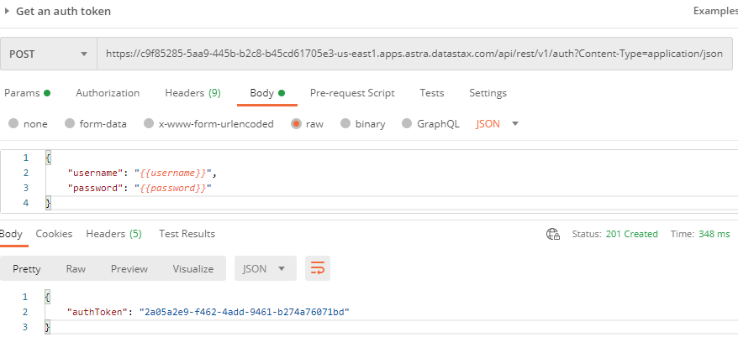
Postman: Get an auth token

Slide 2
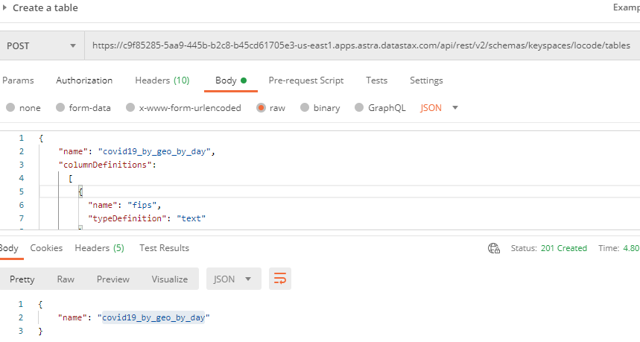
Postman: Create a table

Slide 3
Windows Command Line: dsbulk for initial loading
dsbulk load ^
-url https://raw.githubusercontent.com/CSSEGISandData/COVID-19/master/csse_covid_19_data/csse_covid_19_daily_reports/03-31-2020.csv ^
-k locode ^
-t covid19_by_geo_by_day ^
-b "C://DataStax//secure-connect//secure-connect-locodedb.zip" ^
-u <username> ^
-p <password> ^
-header true ^
-m "FIPS=fips,Admin2=admin2,Province_State=province_state,Country_Region=country_region,Last_Update=last_update, Lat=lat,Long_=long_,Confirmed=confirmed,Deaths=deaths,Recovered=recovered,Active=active,Combined_Key=combined_key"
Username and password provided but auth provider not specified, inferring PlainTextAuthProvider
A cloud secure connect bundle was provided: ignoring all explicit contact points.
A cloud secure connect bundle was provided and selected operation performs writes: changing default consistency level to LOCAL_QUORUM.
Operation directory: C:\DataStax\dsbulk-1.7.0\bin\logs\LOAD_20201012-193450-056000
total | failed | rows/s | p50ms | p99ms | p999ms | batches
2,434 | 0 | 843 | 1,053.55 | 1,174.41 | 1,174.41 | 9.55
Operation LOAD_20201012-193450-056000 completed successfully in 1 second.
Last processed positions can be found in positions.txt

Slide 4
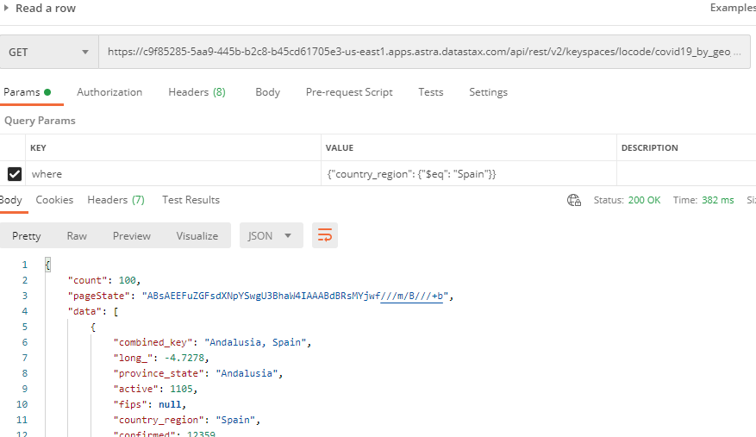
Postman: Get a row

